Slide 1
The Nonlinear Dynamics of Stability in Modular Networks
Paul Heyden
Advisor: Dr. David Egolf
May 10, 2021

Slide 2
Outline
Definitions
Literature Review
Our System and Methods
Results

Slide 3
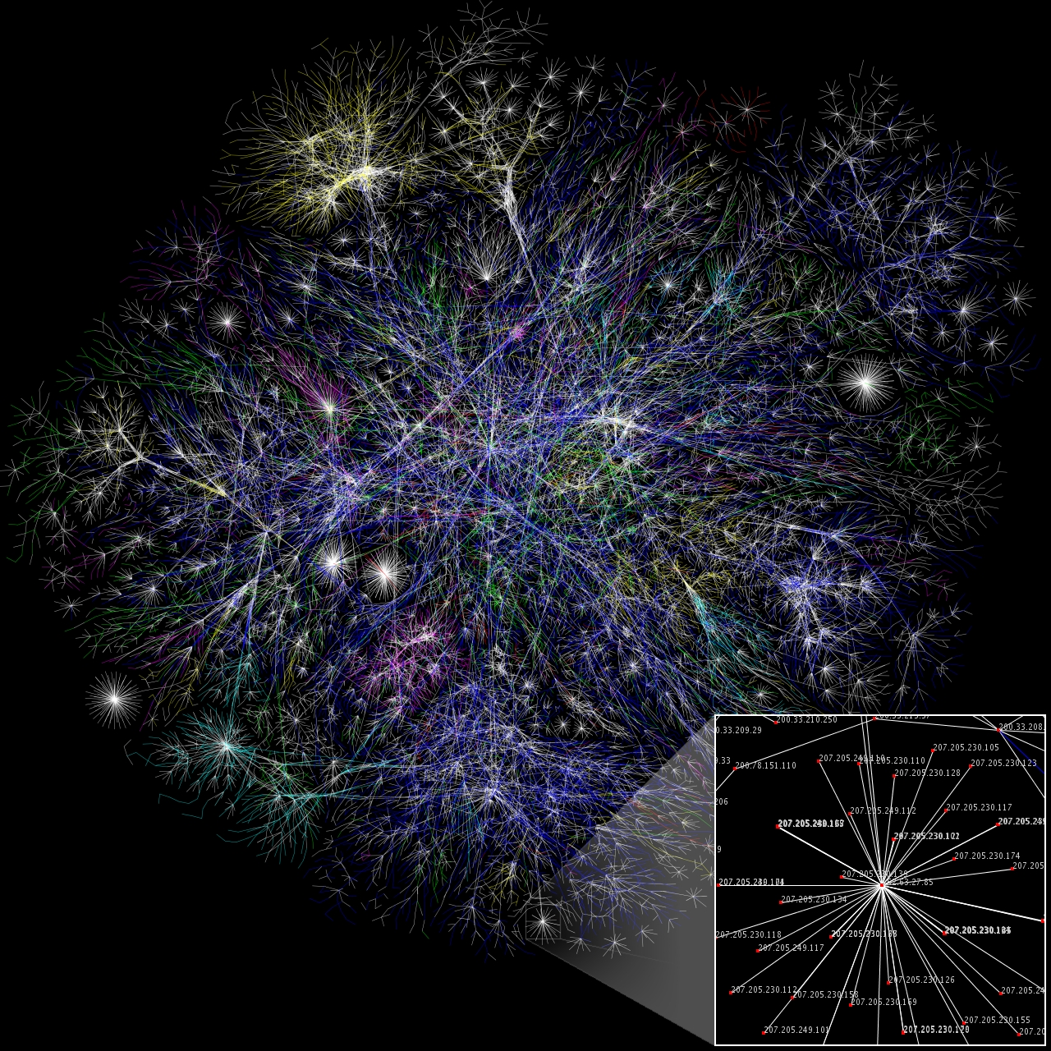
Networks
Food webs
Sick/healthy disease models
IP addresses
Transportation
The Nonlinear Dynamics of Stability in Modular Networks
Notes:
Before we get into chaos and nonlinear dynamics further, let's talk about networks. A network is a group of nodes that are connected to each other. Networks are an important area of study because of their wide range of applications as well as their relevance to modern day life. Transportation and shipping routes, ecological populations of animals, and telecommunications systems are just a few examples. So again, a network is a group of nodes which are connected to each other.

Slide 4

The Nonlinear Dynamics of Stability in Modular Networks
Notes:
Let's probe the transportation network example a little further. You can think of planes being connected via plane routes from city to city. It's more likely that planes will fly between closer cities than across the country. This means our network is modular, or in other words nodes are connected in groups.

Slide 5
The Nonlinear Dynamics of Stability in Modular Networks
Notes:
The nodes connected by plane routes. Why are closer nodes more connected than further nodes? – Imagine more planes are flying from Dallas to Houston than Dallas to San Diego.

Slide 6
Modularity
Groups of nodes are more connected to each other than to nodes in other groups
Modular network
Non-modular network
The Nonlinear Dynamics of Stability in Modular Networks
Notes:
Here’s an abstract picture of networks. In a modular network, groups of nodes are more connected to each other than other groups, just like how planes fly more in a particular region than across the country.

Slide 7
Stability vs. Instability in Systems
Stable systems
Return to same behavior, even if a small perturbation (change) is applied
Periodic or fixed points
Example: a damped pendulum
Unstable systems
Perturbations grow
Often aperiodic
Example: a pendulum balanced in its “up” state
The Nonlinear Dynamics of Stability in Modular Networks
Notes:
Now we're going to talk about the difference between stable and unstable systems. You can think of a pendulum as a stable system, where if you move the ball in a small way, the system will revert back to its original state. In stable systems there is often periodic behavior or fixed points. In unstable cases, such as a pendulum with its ball balanced perfectly on the fulcrum, perturbations grow, meaning there is no return to the original state or behavior. In unstable systems, we see aperiodic behavior.

Slide 8
Study | Findings
MacArthur (1955, Ecology) | More connections, more stability.
Elton (1958) | Less complexity, less stability.
Gardner and Ashby (1970, Nature) | More nodes, less stable; more connections, less stable.
Lord May (1972, Nature) | Stronger connections, less stable; more modular, more stable.
No consensus!
Notes:
A variety of scientists have contemplated stability in systems and they don’t always agree. This is what scientists have thought in the past. In the mid-1950's, MacArthur argued that if a network has more connections for species to interact, then one connection’s failure would be less problematic. Gardner and Ashby performed simple numerical studies on the stability of networks with different numbers of nodes and different degrees of connectivity between nodes. May varied connection strength, meaning how much nodes share with each other, and modularity in his analytical calculations. It's important to note that there's no consensus with researchers in previous decades; some disagree.

Slide 9
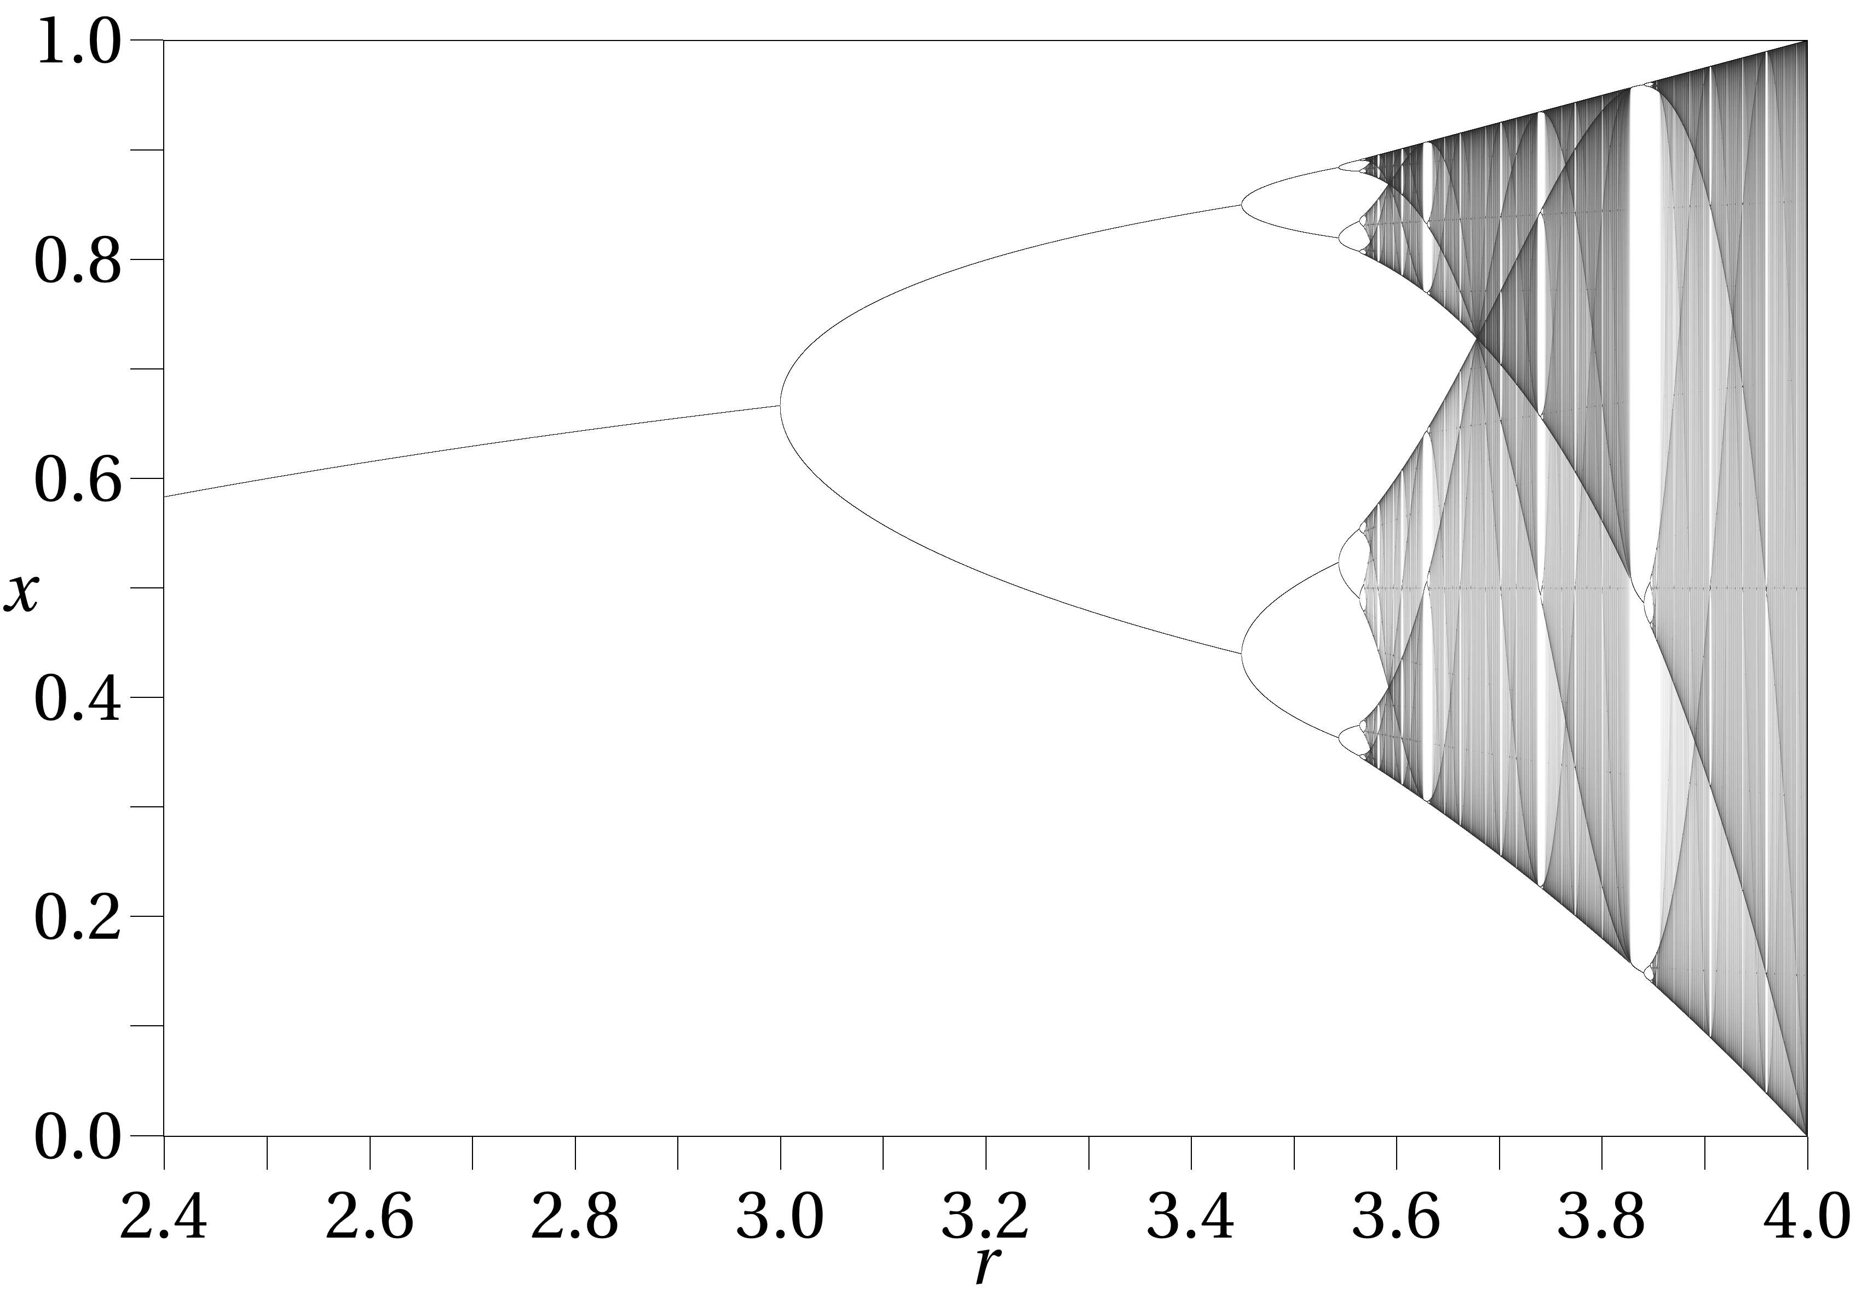


Chaotic vs. Periodic (Stable) Behavior
$x_{i+1}=μx_{i}\left(1−x_{i}\right)$
$μ=3.1$
Period-2 behavior (bottom left)
$μ= 3.58$
Aperiodic (bottom right)
This is what we use in this experiment
$$μ$$
Notes:
So now for the specifics of my research. We’re interested in the same questions as previous researchers had, but for different dynamics on each node. As physicists, we want to model behavior that’s as simple as possible while still capturing the essence of the real-world problem. Let’s start with a simple model for how the populations on our nodes will change. A very famous model from population ecology is the logistic map. Part of the reason why we use this equation is that it can display many types of behavior. For example, at mu = 3.1, there are two fixed points the system returns to, as seen on the bottom left. The value I’m going to be talking about for most of this talk is mu = 3.58, which is where there’s a continuum of values the population can take on. Seen on the bottom right, there is a subtle difference in the values the equation takes on. This means the system is aperiodic; it does not return to its initial state.

Slide 10
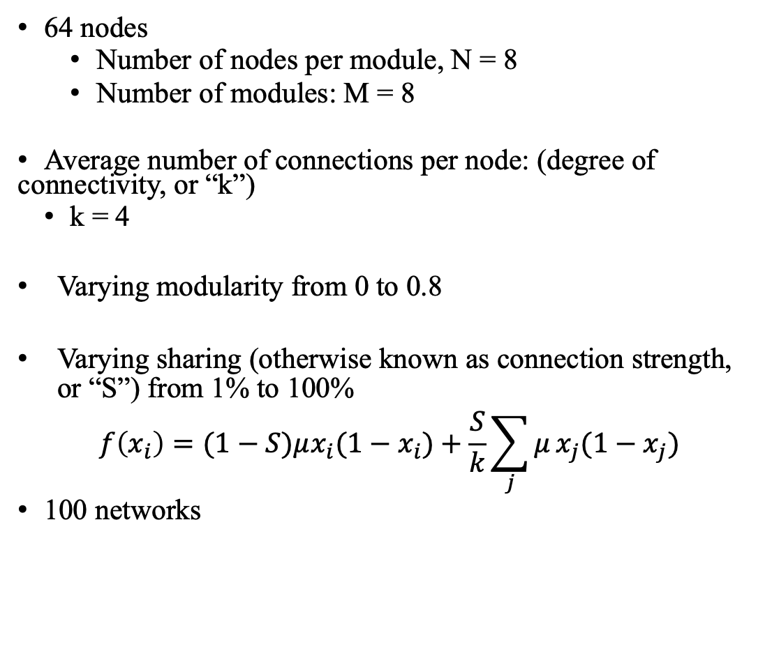
Our System
64 nodes
Number of nodes per module, N = 8
Number of modules: M = 8
Average number of connections per node: (degree of connectivity, or “k”)
k = 4
Varying modularity from 0 to 0.8
Varying sharing (otherwise known as connection strength, or “S”) from 1% to 100%
$$f\left(x_{i}\right)=(1−S)μx_{i}(1−x_{i})+\frac{S}{k}\sum_{j}{μ}x_{j}(1−x_{j})$$
100 networks
Notes:
Now that we know how the nodes are behaving, we have to connect the nodes somehow. It turns out, we can simulate networks with 64 nodes…
Because we want to get a statistical average, we use an ensemble of 100 networks for each parameter that we vary.
Our nodes will communicate with each other by sharing a fraction of their population with their connections. They give up S% of their population at each step, which is why there’s a (1-S) in front of the mu in the equation at the bottom. They then gain a fraction of the populations of each of the nodes they’re connected to, which is the term on the right. This equation is the logistic map on one node plus sharing from node to node.

Slide 11
Big Questions
Is a network of chaotic nodes always unstable?
How is stability affected by modularity?
When do instabilities affect few nodes and when do they affect many nodes?
Notes:
Since networks are all around us, we have certain questions about them. Since people thought about networks in the past, we’re asking similar questions to previous researchers, except we’re considering more complicated dynamics than in the past.
I have a lot of results but a little time, so here are some questions I’ll be answering for you today.
Is a network with chaotic nodal dynamics always unstable?
Will a network be more stable if it is modular? Will it be less stable if there is more node-to-node sharing? When do instabilities affect a few nodes and when do instabilities affect many nodes?

Slide 12
Our Methods
Nonlinear dynamical tools
Lyapunov exponents
Lyapunov vectors
Notes:
We have a complicated dynamical system we’re dealing with, so we’re going to use tools to analyze the dynamics of our networks.
These tools are from nonlinear dynamics.

Slide 13



Lyapunov Exponents
Is the system stable?
$$\left\|v(t)\right\|=\left\|v(0)\right\|{∙e}^{λt}$$
$λ<0$, stable.
$λ>0$, unstable.
Notes:
The simplest tool we use is the Lyapunov exponent, which tells us if the perturbation grows or shrinks. In this equation, v represents our perturbation and the exponent tells us on average how quickly a perturbation will grow or shrink.

Slide 14
When are networks stable/unstable for chaotic nodal dynamics?
Sometimes the nodes are stable.
Notes:
We simulated the Lyapunov exponent for varying connection strengths from 0.01 to 1. We see the networks are initially stable, where there’s positive exponents for the first few values of connection strength, whereas, surprisingly, the chaotic nodes stabilize for medium-low values of sharing. So some networks, even though they have chaotic parameters for nodal dynamics, are actually stable.
Lyapunov exponents are a measure of how stable or unstable a system is. Positive exponents indicate instability, with larger exponents indicating greater sensitivity to perturbations, whereas negative exponents indicate stability, with smaller exponents indicating that perturbations die out more quickly.
In this figure, we show the first Lyapunov exponent $\lambda_1$ as a function of connection strength $S$ for a variety of modularities for mu=3.58. For small to moderate values of the modularity ( M < 0.5$),
the results broadly support May's claim that higher modularity leads to more stability since the exponents are lower as modularity is increased. For larger values of the modularity, the situation is more complicated, and the increased modularity can actually lead to greater instability in networks.
We note that these data are collected using a value of mu = 3.58 in the logistic equation, which is past the point in the bifurcation diagram where the system has infinite period doubling and so individual unconnected nodes would display chaos. In particular, if each node was not connected to any other nodes, we would expect that the nodes would be characterized by a Lyapunov exponent of about 0.105. Indeed, with small connection strength we see that the Lyapunov exponent is very close to 0.105, which we expect because there is not much population sharing from node to node (i.e. there is not much deviation from the original behavior of the logistic map).
When there is just a bit more sharing (0.05 < S < 0.25), however, the system surprisingly stabilizes, at least for M < 0.6. This is intriguing since the underlying dynamics on each node is chaotic. It appears as though the intermediate connection strength somehow stabilizes networks whereas larger connection strengths make the system more chaotic. We do not yet have an explanation for how the intermediate connection strength disrupts the chaotic behavior of each node enough to create a periodic dynamics.

Slide 15
When are networks stable/unstable for chaotic nodal dynamics?
We will analyze three regions of the graph
Notes:
I’ll talk about three regions of the graph: the initial steep decline and stable region, the steady climb, and the plateau where the values reach their maximum.
Lyapunov exponents are a measure of how stable or unstable a system is. Positive exponents indicate instability, with larger exponents indicating greater sensitivity to perturbations, whereas negative exponents indicate stability, with smaller exponents indicating that perturbations die out more quickly.
In this figure, we show the first Lyapunov exponent $\lambda_1$ as a function of connection strength $S$ for a variety of modularities for mu=3.58. For small to moderate values of the modularity ( M < 0.5$),
the results broadly support May's claim that higher modularity leads to more stability since the exponents are lower as modularity is increased. For larger values of the modularity, the situation is more complicated, and the increased modularity can actually lead to greater instability in networks.
We note that these data are collected using a value of mu = 3.58 in the logistic equation, which is past the point in the bifurcation diagram where the system has infinite period doubling and so individual unconnected nodes would display chaos. In particular, if each node was not connected to any other nodes, we would expect that the nodes would be characterized by a Lyapunov exponent of about 0.105. Indeed, with small connection strength we see that the Lyapunov exponent is very close to 0.105, which we expect because there is not much population sharing from node to node (i.e. there is not much deviation from the original behavior of the logistic map).
When there is just a bit more sharing (0.05 < S < 0.25), however, the system surprisingly stabilizes, at least for M < 0.6. This is intriguing since the underlying dynamics on each node is chaotic. It appears as though the intermediate connection strength somehow stabilizes networks whereas larger connection strengths make the system more chaotic. We do not yet have an explanation for how the intermediate connection strength disrupts the chaotic behavior of each node enough to create a periodic dynamics.

Slide 16
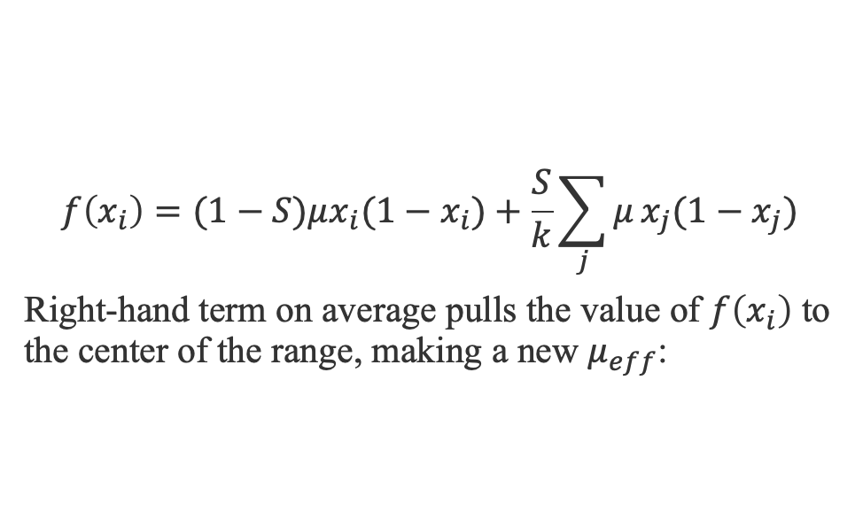

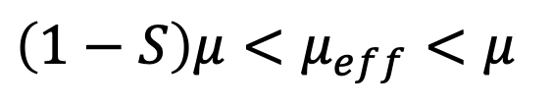
Why stable behavior?
$$f\left(x_{i}\right)=(1−S)μx_{i}(1−x_{i})+\frac{S}{k}\sum_{j}{μ}x_{j}(1−x_{j})$$
Right-hand term on average pulls the value of $f\left(x_{i}\right)$ to the center of the range, making a new $μ_{eff}$:
$\left(1−S\right)μ<μ_{eff}<μ$
$$μ$$
Notes:
The graph on the top right shows the networks are unstable for low connection strengths, then the instability decreases, and eventually the systems become periodic where we see stability on the bottom. Why might this be? We think we have an explanation.
The term on the left decreases mu. The term on the right is an average over almost all uncorrelated nodes, which smooths out their behavior on average and makes the mu value less chaotic. This term would make up the other piece summing up to S mu, but this averaging effect makes the mu value slightly less. we then get a new mu effective which is slightly less than mu and greater than 1-S times mu.
This contributes to an effective mu value which is less than the mu value we inputted. The effective mu value decreases as we increase the connection strength.
As we increase S, this should move us leftward on the bifurcation diagram. We can even look at this more closely for a single network!

Slide 17
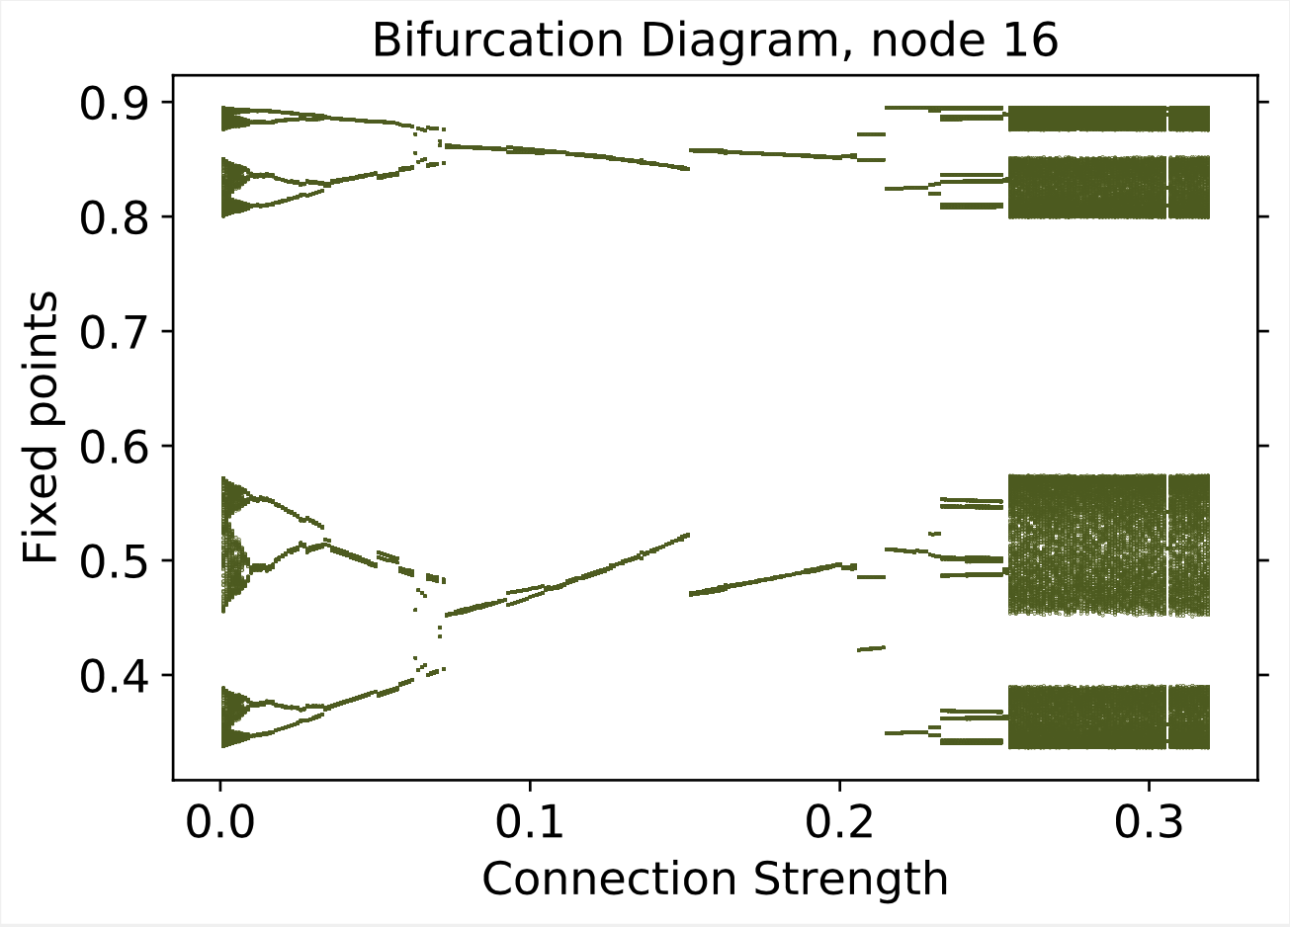

Bifurcation Diagram
Chaos for connection strength less than .02 and greater than .26.
$$μ$$
Notes:
The graph on the right shows an almost mirror image of the graph on the left, where this is the behavior of one of the connection strengths, and we plot all the values of the node population that show up.
Ok. So this is a good explanation of why low connection strengths have stability. What about for higher values of mu?
For S=0.2, the nodes are no longer as independent because they’re sharing much more. This is why the period starts doubling again and why chaos happens for larger connection strength values.

Slide 18



Higher values of $μ$
We expect that $μ_{eff}$ is less than that which gives a period-6 behavior.
Observe the chaotic behavior consistent with this prediction.
$$μ$$
Notes:
When we use mu = 3.84, which is a periodic window of the logistic map, our prediction is we shift over to the left and see chaos. It should be stable, but the mu effective should make it switch to chaos. We’ve run that test, and we see indeed that the values switch and become chaotic. In other words, the system starts as stable but switches to being chaotic. Moreover, the systems become less chaotic as connection strength is increased, leading to a shift left on the bifurcation diagram. Stable behavior only appears for S = 0.001. So we start with stable dynamics, but after a very small amount of sharing, the system becomes chaotic.

Slide 19
Lyapunov Vectors
(Inverse) participation ratios
Tell us how many nodes the perturbation is centered on
Notes:
We’ve figured out what's going on for small connection strength values, so now we will talk about the rise in the exponents. The best tool to help us do this is inverse participation ratios, which tune us into what’s happening in the perturbation.
Lyapunov vectors describe a perturbation which either grows or shrinks on one or many nodes. The Lyapunov vectors represent the different types of perturbations. The exponents I’ve been showing represent the fastest growing perturbation. That perturbation could correspond to one, a few, or all the nodes being perturbed at one time. The participation ratio tells us how many nodes are experiencing the perturbation at one period of time.

Slide 20
Participation Ratio
Transition region from S~0.2 to S~0.7, where nodes are transitioning from local to global.
Notes:
In the region of connection strength 0.2 to 0.6, the exponents are rising, and the inverse participation ratios are also rising. So the system is going from a localized perturbations to global instabilities.
There’s a fairly rapid transition from local to global behavior, where when we say local we mean the perturbation is centered on only one or a few nodes, and global means the perturbation is centered on many nodes or even 64 nodes.
Ok so we see a smooth transition, but we want to probe this further. Let’s take a deeper dive into the number of nodes that are experiencing a perturbation. Networks have different geometries, so maybe the transition region isn’t smooth like it appears on average but is actually sharp.

Slide 21
Transition region for individual networks
The transition is sharper, possibly discontinuous.
Notes:
As a matter of fact, we fact see that the transition between local and global behavior for individual networks is discontinuous. This discontinuity isn’t completely local to global, but it is a very sharp transition.
So we see a discontinuity, but is that the whole story?

Slide 22
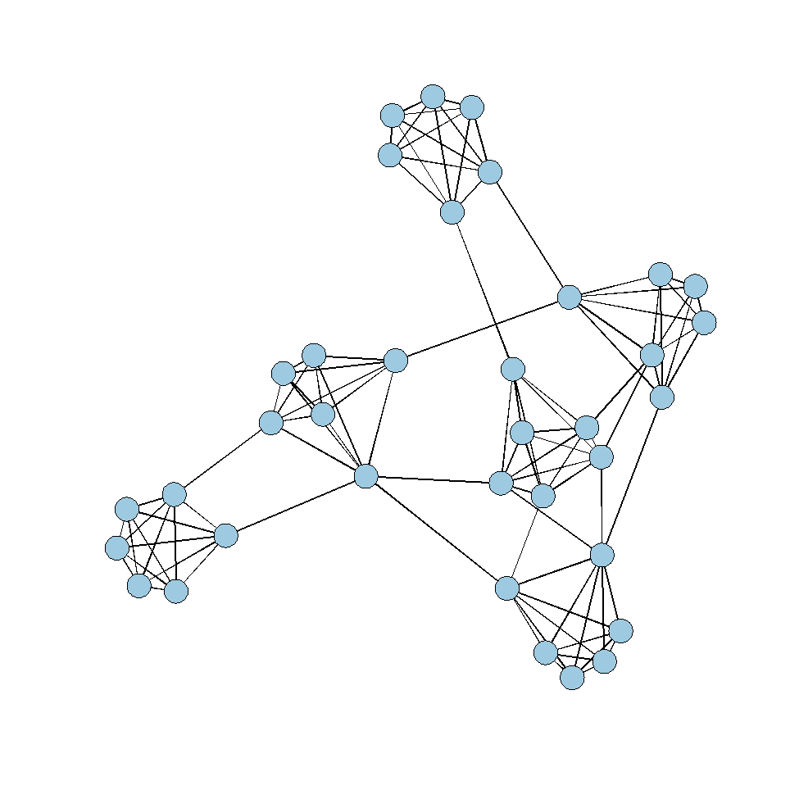
Spread of Perturbations
At some times, the perturbation (transparent oval) is in the top left of the network, at other times it is in the top right, and at other times it is at the bottom.
Notes:
The participation ratio tells us how many nodes a perturbation is centered on at a given time.
What if the perturbation is not localized on one module throughout time, but spreads around from module to module as time goes on?
We made a new measure to capture this spread, called the modified participation ratio. To get this, we calculated the inverse participation ratio on average after a long period of time rather than calculating the participation ratio at each timestep.
If the number of nodes the perturbation was centered on was 18 each time, the participation ratio would be 18, but observe that the perturbation really affects all 64 nodes over all time. The modified participation ratio captures this.

Slide 23
Modified Participation Ratios
The transition is almost completely local to global, and possibly discontinuous.
Notes:
We see that the perturbation does go completely from local to almost completely global, when we take the modified participation ratios. This sharp transition was hidden behind the smoother transition we saw earlier.
The reason the participation ratio graph looks smooth on average is that the jump occurs at different values of S in different networks in our ensemble.

Slide 24
Participation Ratio (Average)
Transition region from S~0.2 to S~0.7, where nodes are transitioning from local to global.
Notes:
Even though the individual networks are discontinuous, the averages look smooth.

Slide 25
Synchronized Chaos
All nodes have the same value, and the system behaves like one node.
Notes:
Now I’m going to talk about the third region on the graph, where all 64 nodes are participating in the perturbation and the first Lyapunov exponent has reached its maximum. In this situation, all the nodes in the network have the same values as each other, meaning the nodes are synchronized, though the system is still chaotic.

Slide 26

Large connection strength values
A synchronized chaotic state is stable to independent single-node perturbations.
$$f\left(x_{i}+δ_{x_{i}}\right)=\left(1−S\right)μ{(x}_{i}+δ_{x_{i}})\left(1−x_{i}−δ_{x_{i}}\right)+Sμx_{i} \left(1−x_{i}\right)$$
$=f\left(x_{i}\right)+\left(1−S\right)μ\left(δ_{x_{i}}\right)\left(1−2x_{i}\right)+O({δ_{x_{i}}}^{2})$
The system is synchronized if the perturbation shrinks, i.e. if
$\left(1−S\right)μ\left|1−2x_{i}\right|<1$
For $μ$=3.58, $0.3≲x_{i}≲0.9,$ so the system is synchronized for
$S=1−\frac{1}{μ\left|1−2x_{i}\right|}>0.65$
Notes:
All the nodes have the same value. If one is slightly changed from the others, it will converge back to the the value that the other nodes have.

Slide 27
Modularity of 0.8 is unlike other modularities
Notes:
Now, I promised you I’d talk about how modularity affects network stability. There’s more in my thesis, so check it out. Having a very large modularity gives a dramatic change in when the system is stable and how unstable it is. As you can see, the modularity of 0.8 has a steep incline in the chaos, and then a steady decline… Can we explain this slow decrease in the Lyapunov exponent? It turns out we can, and the key to understanding the decrease in chaos is noticing that the perturbation is localized on one single module, as we can see from the inverse participation ratio diagram.

Slide 28



Why the decline in chaos for modularity of 0.8?
$$f\left(x_{i}\right)=(1−S)μx_{i}(1−x_{i})+\frac{S}{k}\sum_{j}{μ}x_{j}(1−x_{j})$$
$$f\left(x_{i}\right)=(1−S+\frac{k−1}{k}S)μx_{i}(1−x_{i})+\frac{S}{k}{μx}_{j}(1−x_{j})$$
$=(1−\frac{1}{k}S)μx_{i}(1−x_{i})+\frac{S}{k}μx_{j}(1−x_{j})$
$\left(1−\frac{S}{k}\right)μ<μ_{eff}<μ$
To other modules
Notes:
If a module is synchronized, the sum can be broken into 2 pieces: on average k-1 nodes are in the same module (the term in blue-gray), and they’re synchronized, and one node is outside of the node’s module, which is not synchronized with the other node. This is the term in orange.
For modularity of 0.8, we think the slow decrease in lambda from S=0.2 to S=1 is a recapitulation of the initial decrease explained in the previous slide, but now for modules. On average, for a given node, all but one connection is within a given module. We know from participation ratios that the individual modules have synchronized by S=0.3, as seen on the bottom right.
The blue-gray term represents internal connections within the module, and the orange term represents external connections. As S is changed, we still have an effective mu less than mu, but it changes more slowly because of the division by k.
So, the effect of changing S is diluted by at least a factor of k, where the second decrease in the green is the same phenomenon as the initial decrease, but with modules instead of nodes. This is similar to renormalization in statistical physics, where our block spins are the modules and the effective connection strength is changed.

Slide 29
Conclusion
Networks can be stable even if their nodal dynamics is chaotic!
Networks can be unstable even if their nodal dynamics is stable.
Appears to be a sharp local to global transition as a function of connection strength.
Modularity highly affects the stability of systems.
Instability can be confined within modules.
Notes:
With our tools, we were pleased to find the following results:
Even though mu is unstable, we saw stability. This led us to study a new mu effective analytically.
Furthermore, we see discontinuities for critical connection strength values where the system goes from being completely local to completely global. There is an application to the spread of disease here where if a disease is initially only located in one area, with enough sharing of population, the disease could spread globally very fast.
Moreover, highly modular systems behave quite differently from nonmodular systems, and instability can be confined within modules.

Slide 30
Future work
A theory for local-to-global transitions.
Are our results universal?
Use of different nodal dynamics
Investigate the discontinuities for larger networks
Number of nodes is 128, 256, 512, …
Will there be a larger discontinuity or the same size?
Will there be different critical connection strength values?
Notes:
In the future, we would like to develop an analytical theory for our local to global transitions. We also want to test the behavior of our results and how they depend on different nodal dynamics. For example disease models.

Slide 31
Acknowledgements
Dr. Egolf
Dr. Currie
Dr. Dzakpasu
Dominique Ebedes
My Family
Notes:
Special thanks to Dr. Egolf, Currie, Dr. Dzakpasu, Dominique, and my family.

Slide 32
References
R.H. MacArthur. Fluctuations of animal populations and a measure of community stability. Ecology, 36:533–536, 1955.
C.S. Elton. The Ecology of Invasions by Animals and Plants. Chapman & Hall, London, 1958.
K.E.F. Watt. Principles of Environmental Science. McGraw-Hill, New York, 1973.
M.R. Gardner and W.R. Ashby. Connectance of large dynamic (cybernetic) systems: Critical values for stability. Nature, 228:784, 1970.
R.M. May. Will a large complex system be stable? Nature, 238:413–414, 1972.
B. Stein-Lubrano. Modularity, stability, and chaotic dynamics in networks. 2019.
US Image credit: https://earthobservatory.nasa.gov/images/79800/city-lights-of-the-united-states-2012

